Slide 1
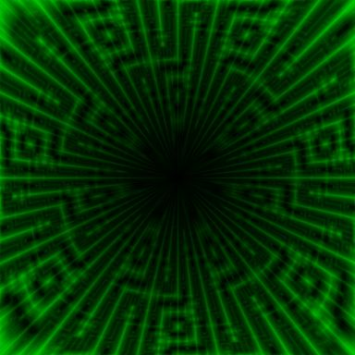
XSYNERGY
100% DECENTRALIZED MATRIX ECOSYSTEM BACKED BY SOLANA RESERVE
www.xsynergy.io

Slide 2


WELCOME
TO XSYNERGY
XSYNERGY is a decentralized rewards system that works for you 24/7.
You earn instantly, right into your wallet.
Your rewards grow automatically through staking.
The longer you stake, the more you make.
No company holding your money. No delays. No hidden control. Everything runs on smart contracts open, transparent, and unstoppable.
Integrity | Transparency | Authenticity
www.xsynergy.io

Slide 3
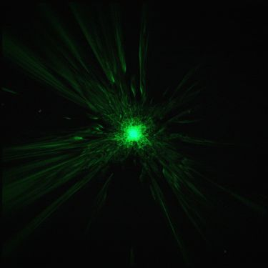
XSYNERGY ORIGIN STORY
This model and Tokenomics were engineered by insiders behind legendary protocols like HEX & TIME. Projects that delivered over 25,000x and even surpassed 100,000x gains. Now comes Xsynergy with a lower fixed supply, zero team tokens, and no insider control. With a Solana strategic reserve and a 5% transaction burn, tokens are removed as the network grows, driving structural scarcity.
www.xsynergy.io

Slide 4

WHAT IS
XSYNERGY?
Xsynergy is a fully decentralized global community project built on transparency and trust.
No Team Tokens, No Human Control, No Admin Control.
Backed by Solana strategic reserve, no new tokens will ever be minted, and the total supply is fixed forever.
Xsynergy has no pre-minting and no presales.
As demand grows, supply reduces, which creates scarcity.
Fixed
88,888,888 Tokens
Creates true scarcity with extremely low circulating supply.
www.xsynergy.io

Slide 5
THE POWER OF XSYNERGY
01
24X7 GLOBAL
ACCESSIBILITY
No KYC. Just connect your wallet and you’re in.
How Xsynergy Redefines Digital World.
02
NO ADMIN
03
TRANSPARENT
RECORDS
04
INSTANT
EXECUTION
Fully autonomous smart contracts manage all laws. No team wallets. No human override.
Every interaction, every reward, and every vault is visible on-chain auditable by anyone, anytime
Every action triggers automated distribution instantly, transparently,
and without delay.
www.xsynergy.io

Slide 6
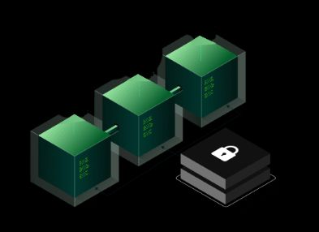
THE WORLD’S FIRST HYBRID MATRIX MODEL
Active Income: Get paid instantly in USDT for every referral you bring.
Passive Income: The longer you stake, the more you earn.
No hardware |No mining Rigs | No complex setup |
Just plug in, stake once & earn daily.
www.xsynergy.io

Slide 7



HOW DO YOU EARN WITH X Energy?
www.xsynergy.io

Slide 8
4 WAYS TO EARN
ACTIVE INCOME
Token Appreciation
Active income, by referring people to the platform
If token price rises you earn
Spillover
STAKING REWARDS
From you earn from upline and downline effort.
Stake and earn daily.
www.xsynergy.io

Slide 9

Let’s Multiply Your Rewards
XSYNERGY VAULT & APY
The XSYNERGY Vault is where your tokens don’t just sit, they multiply.
that holds your tokens & pays you daily rewards. The longer you keep them in the Vault, the more you earn.
TIER | SLOT LEVEL | LOCK DURATION | APY | MAX ROI
STARTER | SLOT 1 | 360 DAYS | 90% | 2X
BRONZE | SLOT 3 | 300 DAYS | 120% | 2.5X
SILVER | SLOT 6 | 200 DAYS | 180% | 3X
GOLD | SLOT 9 | 175 DAYS | 300% | 3.5X
DIAMOND | SLOT 12 | 125 DAYS | 370% | 4X
www.xsynergy.io

Slide 10
XSYNERGY SLOT ENTRY COSTS
1
$25
2
$50
3
$100
4
$200
5
$400
6
$800
7
$1600
8
$3200
9
$6400
10
$12800
11
$25600
12
$51200
13
$102400
www.xsynergy.io

Slide 11

XSYNERGY BOOSTER
Boost Your Earnings with Referrals!
Invite your friends to join Xsynergy and unlock an exclusive 10% APY Boost on your own package.
The boost lasts for 30 days
Directly increases your staking rewards
More invites = more boosts = faster growth
Don’t just earn multiply your rewards with the XSYNERGY Booster!
www.xsynergy.io

Slide 12
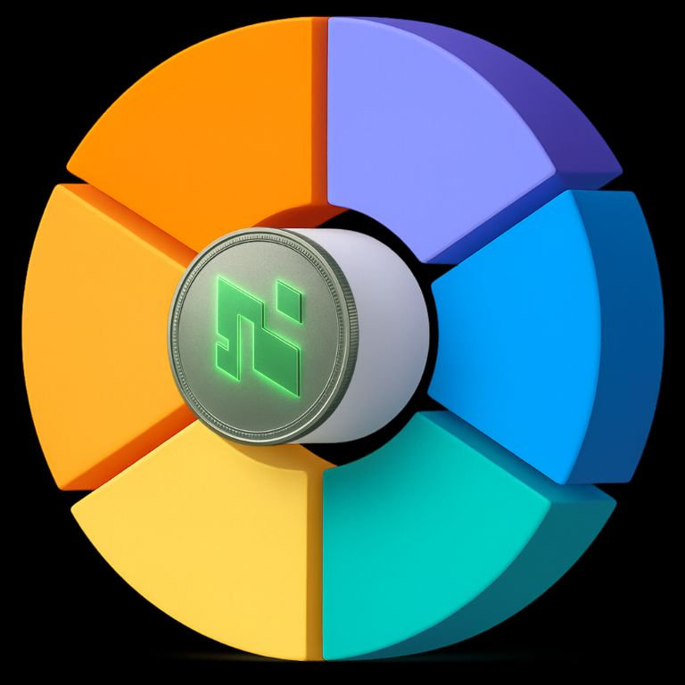
Staking
Rewards
Liquidity Provision
Security & Audit
Referral Multiplier Vault
57.5%
20.0%
XSYNERGY TOKENOMICS
2.5%
10%
Token Name | XSYNERGY
TOKEN TICKER | XSYN
TOTAL SUPPLY | 88,888,888
BLOCKCHAIN | POLYGON
2.5%
7.5%
Marketing & Launch
Emergency Burn Reserve
www.xsynergy.io

Slide 13
XSYNERGY REVENUE DISTRIBUTION
InstantRewards: Earn right away, directly in your wallet
Team Activity: You can benefit from spillover as the network grows.
Passive Growth: A portion of every contribution goes into the Vault, where your rewards keep growing.
No Middlemen. No Delays.
XSYNERGY 1 | 30%
XSYNERGY 2 | 30%
XSYNERGY AUTO VAULT STAKING | 25%
XSYNERGY SOLANA RESERVE FUND | 10%
XSYNERGY BUY BACK AND BURN | 5%
www.xsynergy.io

Slide 14


XSYNERGY 1
Your First Step to Infinite Earnings
ID
Here’s How it Works:
Spot 1: Your first referral pays you instantly 100% direct to your wallet.
Spot 2: Your second referral also pays you instantly 100% direct to your wallet.
Spot 3: Your third referral pays your sponsor above. and it restarts your cycle so, you can earn again from the next 3 referrals.
What Does “Cycle” Mean?
A cycle is just one round of 3 referrals. Every time you complete 3 spots, the system reopens a new cycle for you automatically. This means you can keep earning over and over without ever buying in again.
ID
1
2
3
www.xsynergy.io

Slide 15
XSYNERGY 2 HOW IT WORKS?
ID
Slots 1 & 2: Slots 1 & 2: 100% of available commissions goes to your upline keeping the system flowing and rewarding teamwork.
Slots 3, 4 & 5: you can earn hundred percent available commissions instantly to your wallet.
Slot 6 (Closing Slot): This slot doesn’t pay you. Instead, it triggers an automatic reinvestment, reopening your XSYNERGY2 cycle. The payout goes to your higher partner, while you keep your position active to earn again and again.
1
2
Result: You get three direct instant payouts every cycle and the system automatically restarts so you never miss a chance to keep earning.
3
4
5
6
www.xsynergy.io

Slide 16
XSYNERGY MATRIX GROWTH
FEATURE | XSYNERGY 1 | XSYNERGY 2
Structure | 3 SPOTS | 6 SPOTS
Who Fills Spots | ONLY YOUR PERSONAL REFERRALS | FROM YOUR INVITES, UPLINE SPILLOVER, AND TEAM ACTIVITY
Payout Flow | SPOT 1: 100% PAYOUT TO YOUR WALLET SPOT 2: 100% PAYOUT TO YOUR WALLET SPOT 3: 100% PAYOUT AS REINVEST | SLOTS 1 & 2: 100% PAYOUT TO YOUR UPLINE SLOTS 3, 4 & 5: 100% PAYOUT TO YOUR WALLET SLOT 6: REINVEST (100% PAYOUT TO PERSON ABOVE)
Reinvestment | SPOT 3 TRIGGERS REOPEN OF CYCLE | SLOT 6 TRIGGERS REOPEN OF CYCLE
Core Benefit | QUICK START, INSTANT INCOME FROM FIRST 2 PARTNERS | TEAM POWER + SPILLOVER = BIGGER NETWORK & MULTIPLE INCOME STREAMS
Earning Potential | UNLIMITED CYCLES AS YOUR 3 SPOTS KEEP REFILLING | MASS DUPLICATION WITH TEAM EFFORT + SPILLOVER FOR CONTINUOUS CYCLES
www.xsynergy.io

Slide 17

GET STARTED NOW
Create Wallet
(MetaMask,
Trust Wallet
& Any
Web 3 Wallet)
So, connect your web3 wallet to Xsynergy.io by to buy Xsynergy slots to buy energy slots
Add Polygon Network & USDT
www.xsynergy.io

Slide 18
DISCLAIMER
Nature of Purchase: By purchasing an Xsynergy NFT, you acquire a digital collectible and access credential to certain educational materials, community features, mastermind participation, and other utilities that Xsynergy may make available. The NFT provides utility access only. It is not an equity interest, partnership, security, or financial investment.
Purpose of Proceeds: from NFT sales support education, community programs, infrastructure, and ecosystem development. Purchases should be viewed as crowdfunding-style support for these purposes, not as an investment vehicle.
No Investment / No Expectationof Profit: Xsynergy does not offer financial products, securities, or guarantees of income. Nothing communicated by Xsynergy or its of ciliates is a solicitation to buy, sell, or invest in any digital asset. Participants should form no expectation of profit from the efforts of Xsynergy or others.
Utilities May Change: Utilities, features, and access associated with NFTs are not guaranteed and may be modified, suspended, or discontinued in whole or in part at any time for legal, regulatory, security, technical, or business reasons. Availability can vary by region and over time.
No Price or Performance Guarantees: Xsynergy makes no representation that any NFT or related utility will have or retain value, appreciate, generate income, or produce dividends. Market outcomes are outside the control of Xsynergy.
Risk Disclosure: Interacting with NFTs, blockchains, and related technologies involves inherent risks, including volatility, technology failures, loss of access credentials, and regulatory changes. Conduct independent research and due diligence. All purchases are at your own risk.
Key Notice (Plain English): Xsynergy NFTs are access collectibles, not investments. Utilities may change or end at any time for legal or business reasons. No profit or price guarantees. Do your own research.
No Warranties; Reservation of Rights: All information and utilities are provided “as is” without warranties of any kind. Xsynergy reserves all rights not expressly granted herein.
Jurisdiction & Interpretation: This disclaimer is drafted in a conservative, cross-border style intended to align with common international approaches to consumer protection and digital-asset risk disclosures. Local laws vary; participants are responsible for their own compliance

Slide 19

THANKYOU
LET'S JOIN THE HANDS TOGETHER
Transparent | Automated | Limitless | Powered by Smart Contracts | Join The Revolution| Stick Your Future
www.xsynergy.io

